Slide 1
MSS
School of computer Application KIIT university

Slide 2
Classification of IS
IS
Support
of
Business
Operation
Operations
Support
System
Management
Support
System
Support of
Management
Decision making
Specialized processing
System
Transaction
processing
System
Process
Control
System
Enterprise
Collaboration
System
Management
Information
System
Decision
Support
System
Executive
Information
System
Specialized processing
System
Processing
Business
Transaction
Control of
Industrial
Process
Team &
Work group
Collaboration
Pre specified
Reporting
For managers
Interactive
Decision
Support
Information
Tailored for
Executive
Expert
System
Knowledge
Management
System
Strategic
Information
System
Functional
Business
System
Expert Advice to
Decision Makers
Manage
Organizational
Knowledge
Support
Competitive advantage
Support
Basic Business
Function

Slide 3
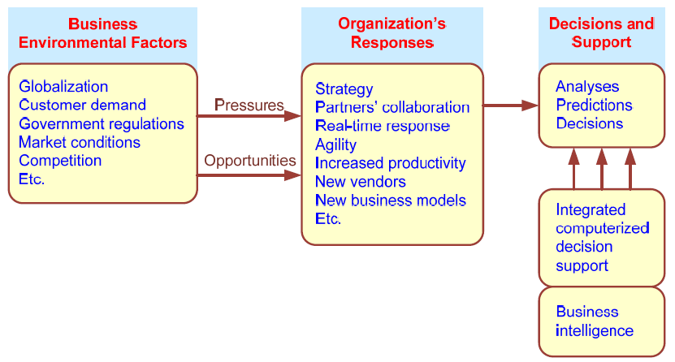
Business Pressures–Responses–Support Model

Slide 4
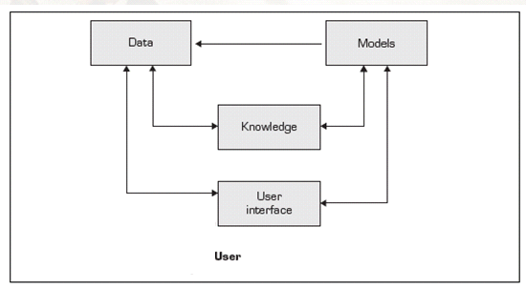
The Concept of Decision Support Systems

Slide 5
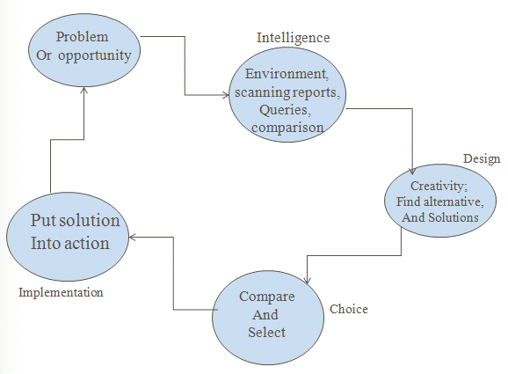
A Framework for Computerized Decision Support:

Slide 6
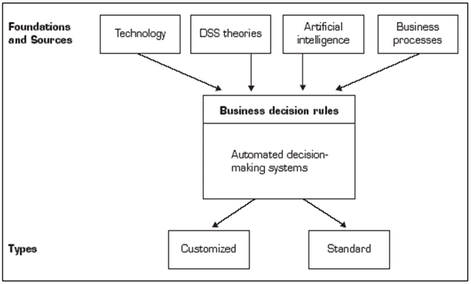
➢Computer support for structured decisions

Slide 7
Evolution of Business Intelligence (BI)

Slide 8
A High-Level Architecture of BI.

Slide 9
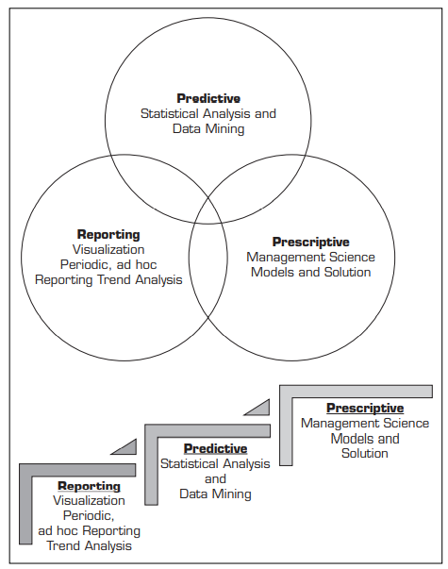
Business Analytics Overview

